Slide 1
Review:
Cells make up _________, tissues make up __________, and organs make up ___________, which make up an ________.
2) The three parts of the cell theory are…..
3) Some cell parts that I learned about yesterday include:

Slide 2
Today’s Essential Questions
Why must a cell divide?
What happens in mitosis?

Slide 3
Your Role today:
1)What basic structures are involved in cell division?
2) Why must a cell divide?
3) What happens in mitosis?
  -View and list important information on your NTS from the interactive website.
  -Formulate questions that you would like to ask an expert about out of control mitosis/cancer.

Slide 4
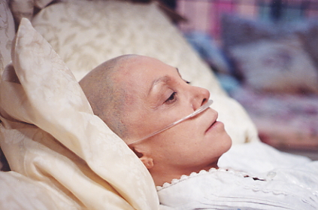
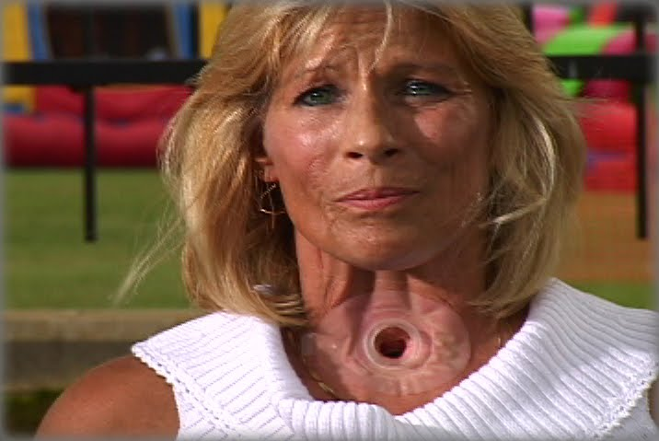
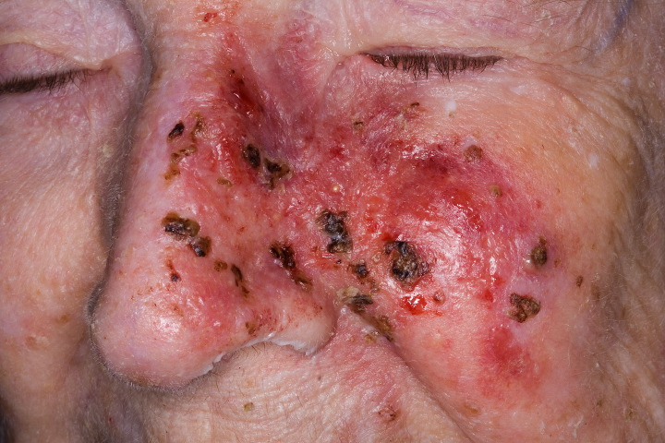
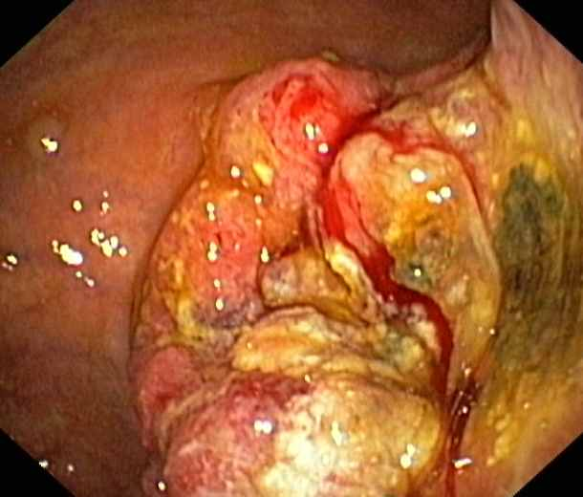
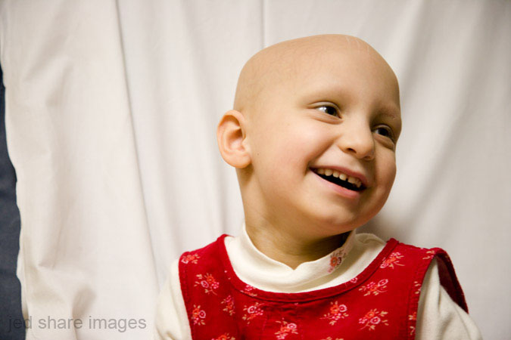
What do these pictures have in common?

Slide 5
DISCUSS:
Do have someone in your family who has cancer?
What causes this disease?

Slide 6
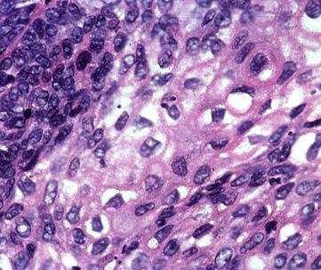
The answer lies in abnormal cell division-
Out of control mitosis.

Slide 7
Go to:
http://plaza.ufl.edu/alallen/pgl/modules/rio/stingarees/module/index.html
Step 1: Read and interact Basic Cell Parts Involved in Cell Division. Fill in NTS. Then, Stop.
Step 2: Together as a group, read through Why must a cell divide? Discuss next slides. Then, stop.

Slide 8
STEP 3: Read and interact with What happens in mitosis? Fill in NTS, then stop.
Step 4: Check aloud, with teacher.
Step 5: NOW, use www.bubbl.us to explain what you have learned.
Step 6: If you could meet with an expert to ask questions about out of control mitosis or cancer, list 5 questions you would like to ask.

Slide 9
Review – Basic Cell Parts involved in cell division
Cell membrane
Nucleus
Centrioles
Microtubules

Slide 10
Review – Why Must a Cell Divide?
As a cell gets larger, this ratio gets smaller, meaning the cell membrane cannot supply the inside with what it needs to survive.

Slide 11
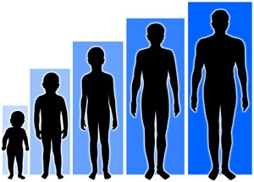
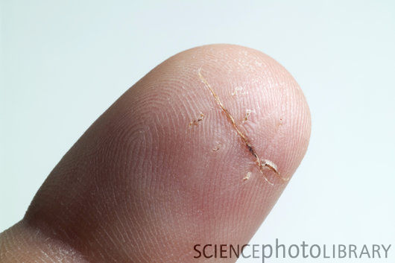
Review: What does mitosis do?
For organisms to GROW
2) For organisms to
HEAL & REPAIR INJURIES

