Slide 1
Review:
What 4 parts are involved in cell division?
2) Why must cells divide?
3) What are the basic reasons cells divide?

Slide 2
Today’s Essential Questions
How is cell division controlled?
What happens if cell division spirals
out of control?

Slide 3
Your Role today:
1)How is mitosis/cell division controlled?
2) What happens if
Mitosis spirals out of control?
-View, list, & print important information from the interactive website in outline form on the RTW website.
View a website &video & continue your previous outline by on the RTW Website stating at least 3 main points and the sub points you learned from this article at mednews.

Slide 4
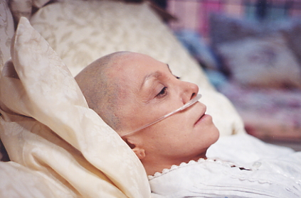
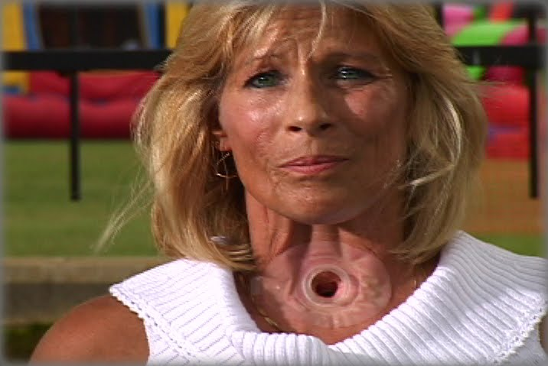
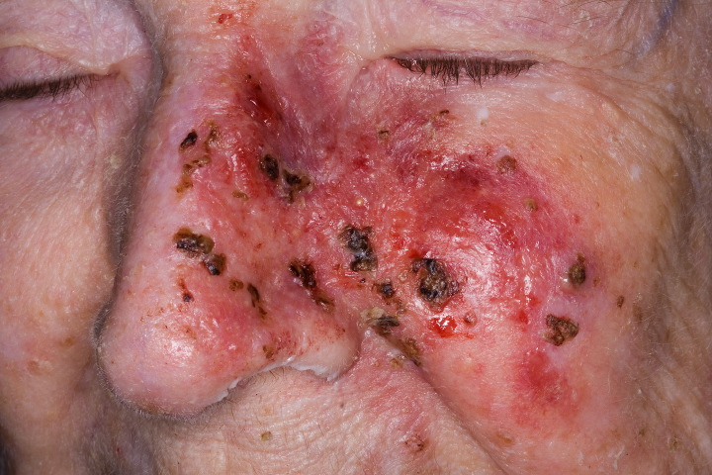
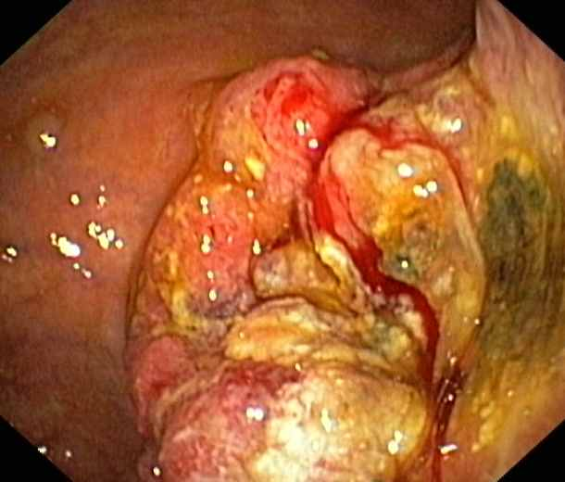
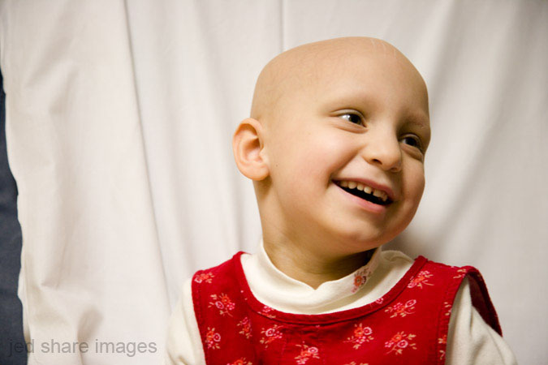
What do these pictures have in common?

Slide 5
DISCUSS:
What causes this disease?

Slide 6
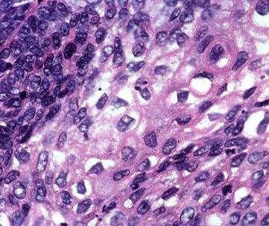
The answer lies in abnormal cell division-
Out of control mitosis.

Slide 7
Go to:
http://plaza.ufl.edu/alallen/pgl/modules/rio/stingarees/module/index.html
Step 1:
Read and interact with Built in Controls for Mitosis. Go to http://interactives.mped.org/notetaker722.aspx to create an outline of the information learned there.
Step 2:
Go to: http://www.medicalnewstoday.com/info/cancer-oncology/ Read and watch the article and video found there. Continue outline created at the above site by listing 3 main
Important points you learned while there with at least 3 sub-
Points under each.

Slide 8
STEP 3: Discuss findings today with teacher.
STEP 4: Discuss tomorrow’s Skype lesson & Procedures.
Step 5: Complete the Extension activity. Explain or create an artistic work on paint or WORD to describe how you would feel if you were diagnosed with cancer. What would you do with your life at this point?

Slide 9
Review – Built in Controls
Contact inhibition
Go-No-Go Switches

